Slide 1
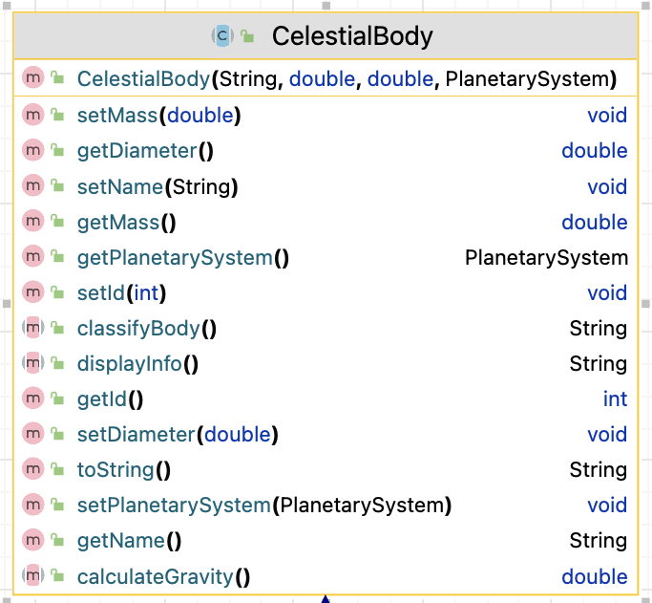
Class Name
Constructor
Instance Fields
Instance fields – data types
Methods
methods– return types

